Slide 2
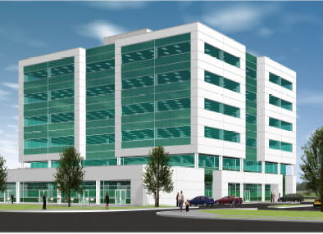
Location, Location, Location
Minutes from:
Scarborough Grace General Hospital
Scarborough General Hospital
Rouge Valley Healthcare
North North York General Hospital
Toronto East General Hospital
Sunnybrook Health Sciences Centre
401 highway
Ellesmere Medical Health Care Centre 520 Ellesmere Road, Scarborough, ON

Slide 3
Designed to Maximize Physician Productivity
Managed Group Practice
Productivity increases with the following four factors:
Achieve up to 30% greater efficiency
1 Style
3 Staff
2 Space
4 Systems

Slide 4
Style
1
Recognizes physician own unique style of practice
Physician’s style is greatly dictated by his/her current work environment
The Managed Group Practice Model increases the physician’s patient flow rate
Most physicians currently outgrow their space during the first few years of practice as their patients get older and their requirements evolve.

Slide 5
Space
2
The facility design greatly improves workflow patterns, particularly within Managed Group Practice floors.
Ample parking for both physicians and patients
Dedicated Doctor’s office fully furnished
Two exam rooms fully equipped
Professionally designed layout for patient waiting areas
Nursing and Medical Assistant stations to assist physician with patient flow rates
Patient-centric design
Designed by health care professionals

Slide 6
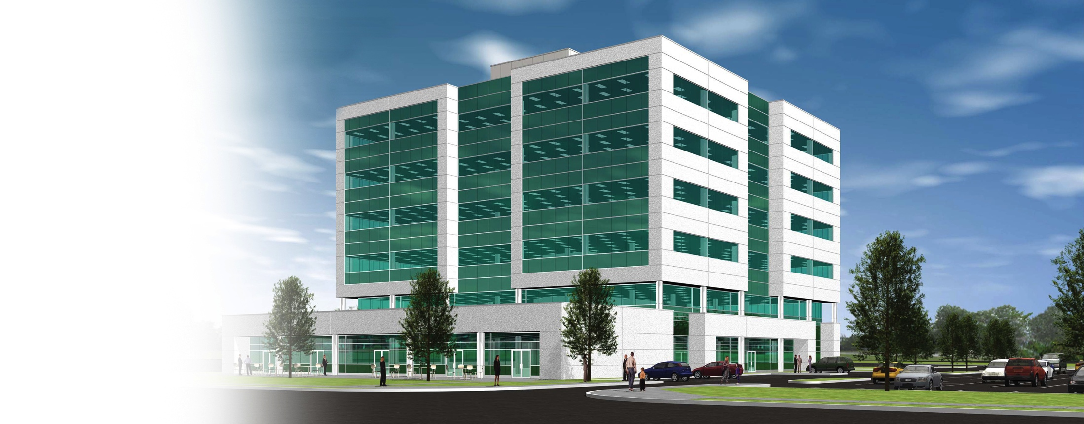
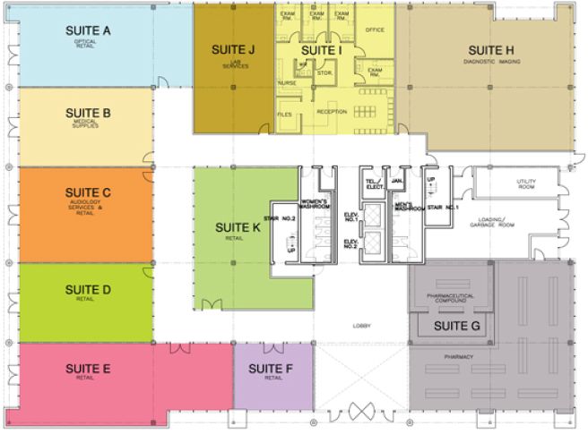
Services and Amenities
Ground Floor:
Retail and Medical Services
Compound Pharmacy
Urgent Care Clinic
Nuclear Medicine
Lab Services
Medical Supplies
Optical
Dentist
Coffee Shop
Basement Level
Doctors’ Lounge
Exclusive Gym for Staff
Diagnostic Imaging
Learning Centres
Full-Service Staff Cafeteria

Slide 7
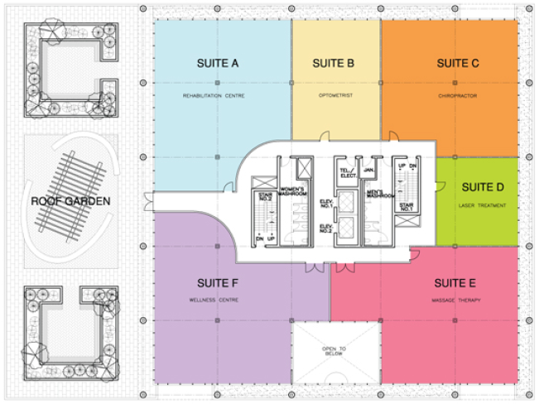
Services and Amenities
Second Floor:
Medical Services
Cardiology
Rehab Centre
Wellness Centre
Laser Treatment
Chiropractor
Optometrist
Laser Eye Centre
Massage Therapy
Roof Garden

Slide 8
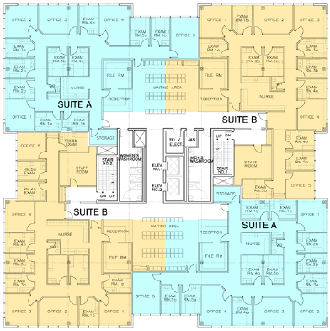
Managed Group Practices
Third & Fourth Floors:
5 Physicians + 5 Nurses
20 Doctors/floor
Office + 2 Exam Rooms/MD
Large patient reception areas
Integrated digital learning throughout
Designed for:
FHG
FHO
FHT

Slide 9
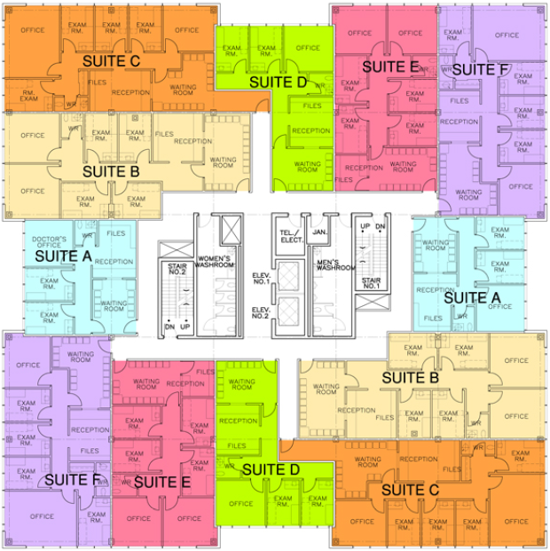
Solo and Dual Practitioners
Fifth & Sixth Floors:
Solo Physician space with 2 Exam Rooms + 1 Office
Dual Physician design with 4 Exam Rooms + 2 Offices
Suites ranging from 700-1400 sq. ft.
Proximity to large base of referring Physicians
Dedicated patient waiting areas
Large windows in most Offices and Exam Rooms

Slide 10
Staff
3
Expert support staff to meet your needs and working style:
Office Administrators
Medical Assistants
IT Technicians
Receptionists
Filing clerks
Billing clerks
Our team will help to improve your efficiency up to 30% while optimizing your practice

Slide 11
Systems
4
Every service provider & physician will be linked to a common EMR system
EMR will enhance the efficiency of the Group Managed Practice
Lab/X-Ray results will have quick “turn around” times
Pharmacy will have access to electronic prescription system
Improved communications reduces “patient wait” time and increases patient flow rate

Slide 12
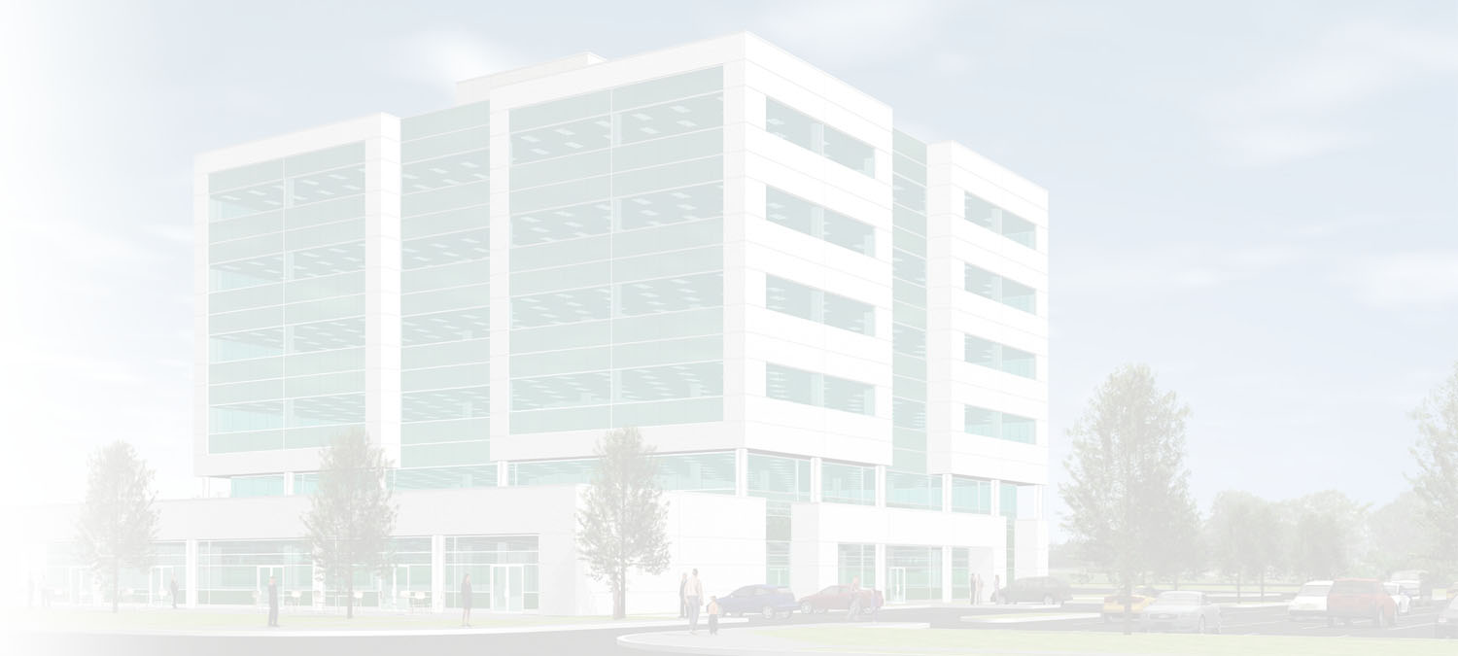
Patient Flow Rate: Vital to Your Practice
Facility Design Considerations:
Generates patient flow rates of 5-12 per hour/Physician
Large parking capacity
Well-designed waiting areas
Ample exam rooms
EMR system
Medical assistants and support/vital to physicians’ practice
Increases the efficiency of check-in/out times
Maximizes optimal revenue generating capacity

Slide 13
Ellesmere Medical Health Care Centre
Two medical practice models to choose from:
Group Managed Practice
Designed to optimize patient flow rates
Solo physician looking to work with other support staff
Turn-key practice solution
Solo/Dual Physician Office
Looking to continue practice on his/her own in a state of the art medical centre
In-house amenities & services
One-stop shop for this patients
Easier referrals and services to optimize practice

Slide 14
Solo / Dual Physician Practices
Ideal for those who want a traditional office model
Physician has total control of his/her own office
Access to a state of the art facility
Large base of referring Physicians
Integrated learning centres for CHE programs
Proximity to hospitals and highways
High residential density and large employment area

Slide 15
Managed Group Practices
Eliminates overhead costs
Reduce staffing concerns
Turn-key and ready for you and your patients:
Nurses and clinical assistants
EMR system
Billing administrators
Medical equipment & office supplies
Stylish office design and furniture
Digital signage and learning platforms

Slide 16
Managed Group Practices
Hassle-Free:
Maintenance issues
Staff turnover
Vacation coverage backup
Ordering of medical/office supplies
Professional office administrators

Slide 17
Urgent Care Centre
Opportunity to work in an “ER” type setting
Beneficial for new physicians to build patient base
Premium billing for after-hours care
Convenient for patients due to shorter wait times
Coordination with local ERs to manage overflow

Slide 18
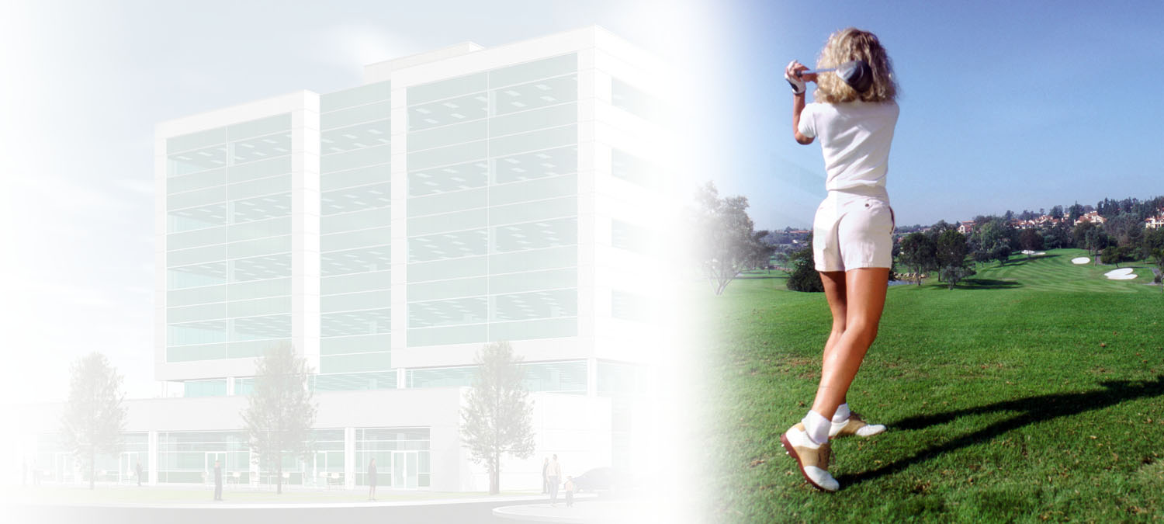
Work/Life Balance
Physicians benefit from:
Flexibility in choosing your work hours
Vacation facilitated
Maternity leave facilitated
Part-time hours available

Slide 19
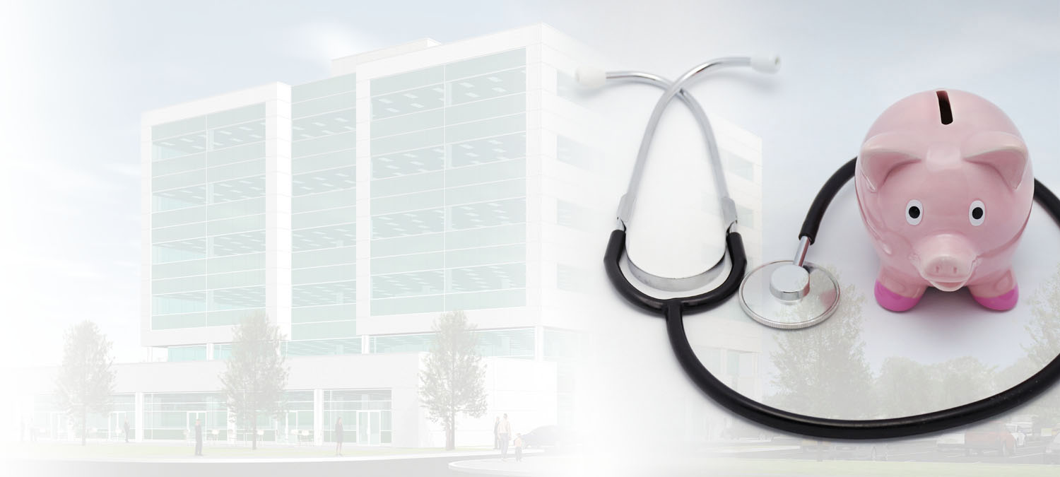
Group Managed Practices
Remuneration:
70/30 split for physicians seeing 5 patients per hour
80/20 split for physicians seeing 8 patients per hour

Slide 20
Financial Consideration
Typical financial scenario:
Doctor with annual gross billings of $250,000
Rents office space
Gross Billings $250,000 % of Billings
Support Staff $ 75,000 30%
Operating Expenses $ 25,000 10%
Rent (1,000 @ $20) $ 25,000 10%
TOTAL EARNINGS $125,000 50%

Slide 21
Efficiency Gains from Group Managed Practices
Physician Billings at EMHCC | Split | Physician Earnings | Incremental Physician Earnings
$250,000 | 70-30 | $175,000 | $ 50,000
$350,000 | 75-25 | $262,500 | $ 112,500
$400,000 | 75-25 | $300,000 | $ 150,000
$500,000 | 80-20 | $400,000 | $ 250,000

Slide 22
Additional Incentives
Signing bonus for first 20 physicians who sign a 5-yr. agreement
$25,000 for full time physician
$10,000 for part-time physician
Reserved parking spaces
Referral fee program (for referring other physicians)
Moving package
Lease buy-out assistance

Slide 23
Making The Right Move
Planning a move for physicians can be overwhelming:
Locating new office space
Dealing with lease negotiations
Notifying patients
Reviewing support staff numbers
Examining current practice efficiencies
Costs of relocating
Make it easier:
The move is facilitated by a state of the art medical health care centre
Group Managed Practice provides each physician improved life style possibilities
30% more efficient for the physician with less stress
No cost to physician joining a Group Managed Practice at EMHCC

Slide 24
A State of the Art Health Care Facility
Designed by Health Care Professionals

